Slide 1
CBM progress report 20 VII 2021
@Julian Nowak

Slide 2
1. Analysis Tree
Installing software
Making first histograms from GEANT4 simulations (/lustre/cbm/users/lubynets/cbm2atree/outputs/apr20_fr_18.2.1_fs_jun19p1/dcmqgsm_smm_pluto/auau/12agev/mbias/sis100_electron_target_25_mkm/AT2
Running our own macros via ssh

Slide 3
Momentums – e.g., p_{y}

Slide 4
Momentums – e.g., p_{z}

Slide 5
Momentums – e.g., p_{T}

Slide 6
Azimuthal angle

Slide 7
Pseudorapidity

Slide 8
Correlations: sim-rec p_{y}, rec p_{x}- p_{y}

Slide 9
Correlations: sim –rec azimuthal angle, sim-rec psuedorapidity

Slide 10
Correlations: impact factor - multiplicty

Slide 11
Correlations: sign(charge)*momentum – mass^2
Important for reconstruction of charged particles (more in Jan’s work)

Slide 12
2. PFSimple – framework for short-lived particles reconstruction
Installing software
Making first histograms from GEANT4 simulations (auau/12agev/mbias/sis100_electron_apr20_target_25_mkm/TGeant4) – for 100 files, each 1000 events – TBD: histograms from 5.000.000 events
Running our own macros on batch farm (slurm)
Histograms shown for 0.99825 cos cut

Slide 13
Momentums – e.g., p_{x}

Slide 14
Momentums – e.g., p_{y} (sic!)

Slide 15
Momentums – e.g., p_{z}

Slide 16
Momentums – e.g., p_{T}

Slide 17
Momentums – difference between candidates (reconstructed) and simulated

Slide 18
Correlations: rec-sim p_{x}- p_{y}

Slide 19





Correlations: rec-sim p_{x}- p_{y}
$$Δε^{2}={\left(\frac{δε}{δN_{s}}\right)}^{2}⋅ΔN_{s}^{2}+{\left(\frac{δε}{δN_{r}}\right)}^{2}⋅ΔN_{r}^{2}⇒ \frac{Δε}{ε}=\sqrt{\frac{1}{N_{r}}+\frac{1}{N_{s}}}$$
$$ε=\frac{N_{r}}{N_{S}}$$
$$ΔN=\sqrt{N}$$

Slide 20
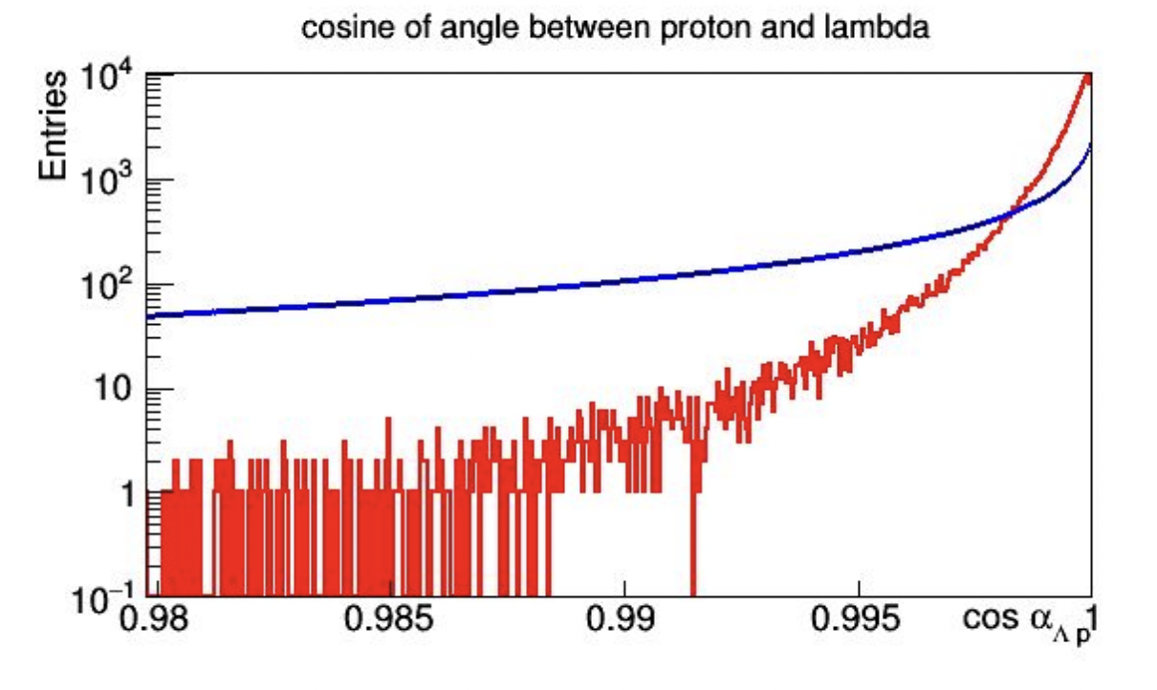
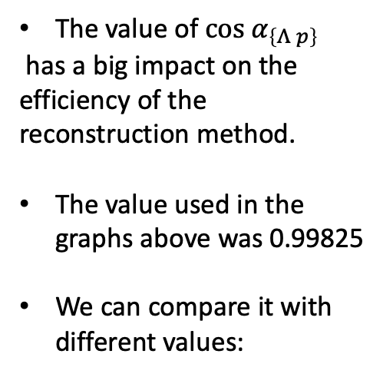
Cosine cut
The value of $cos α_{\left\{Λ p\right\}}$
has a big impact on the efficiency of the reconstruction method.
The value used in the graphs above was 0.99825
We can compare it with different values:
@ Oleksii Lubynets: https://indico.gsi.de/event/10062/contributions/48045/attachments/33320/43053/PFSimple4Lambda_Highlights_36CM.pdf

Slide 21
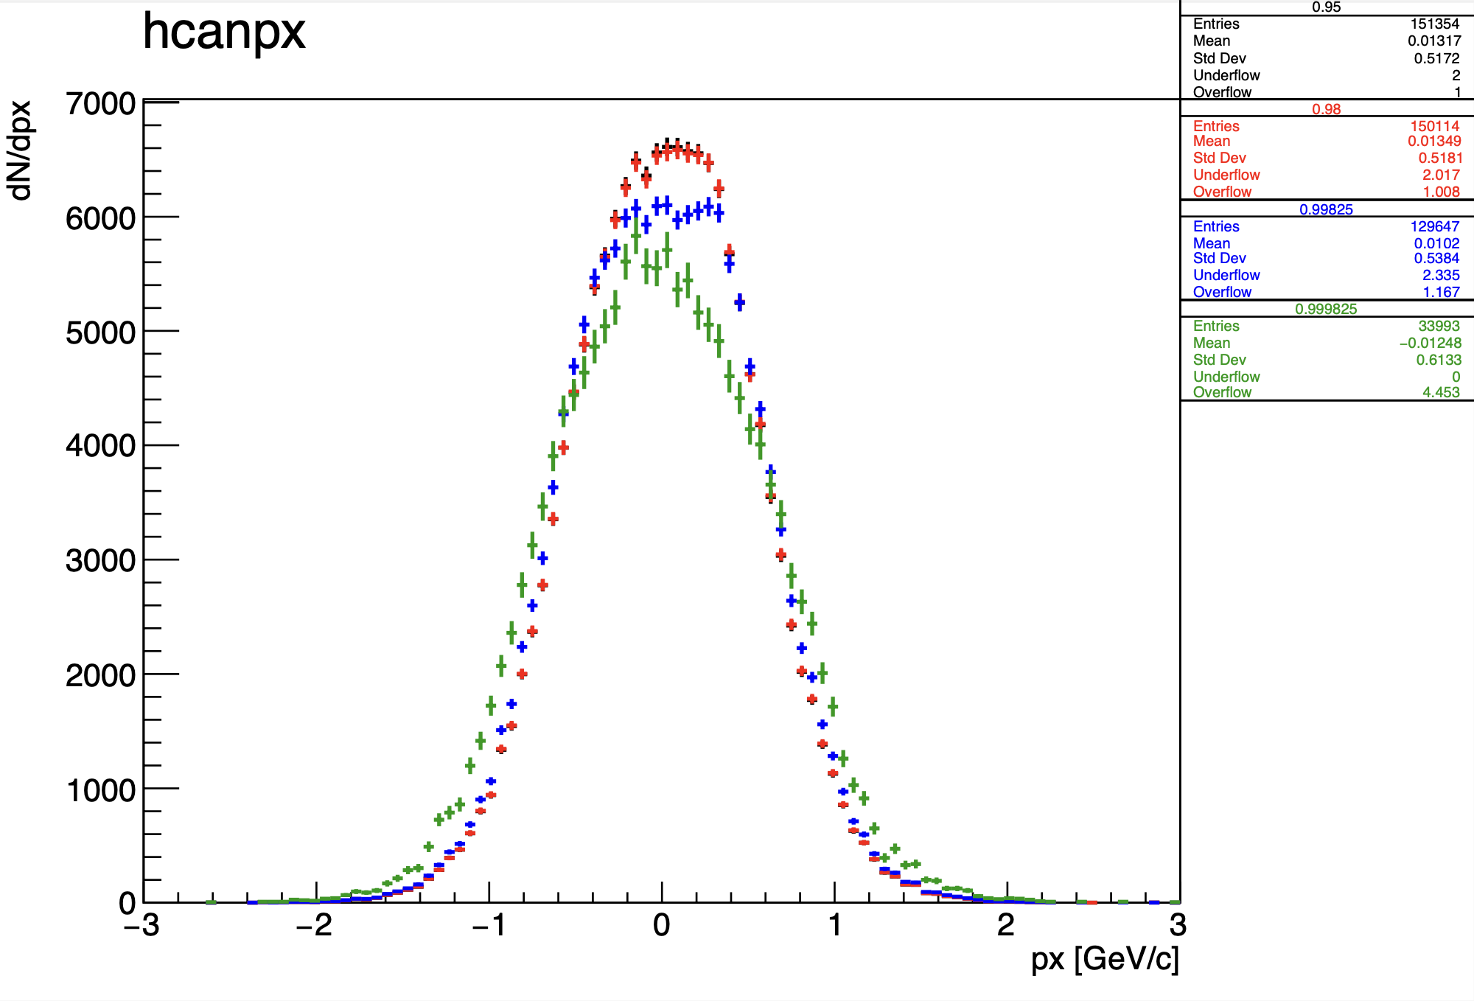
Momentums – e.g., p_{x}
Notes:
Normalized to the same integral

Slide 22
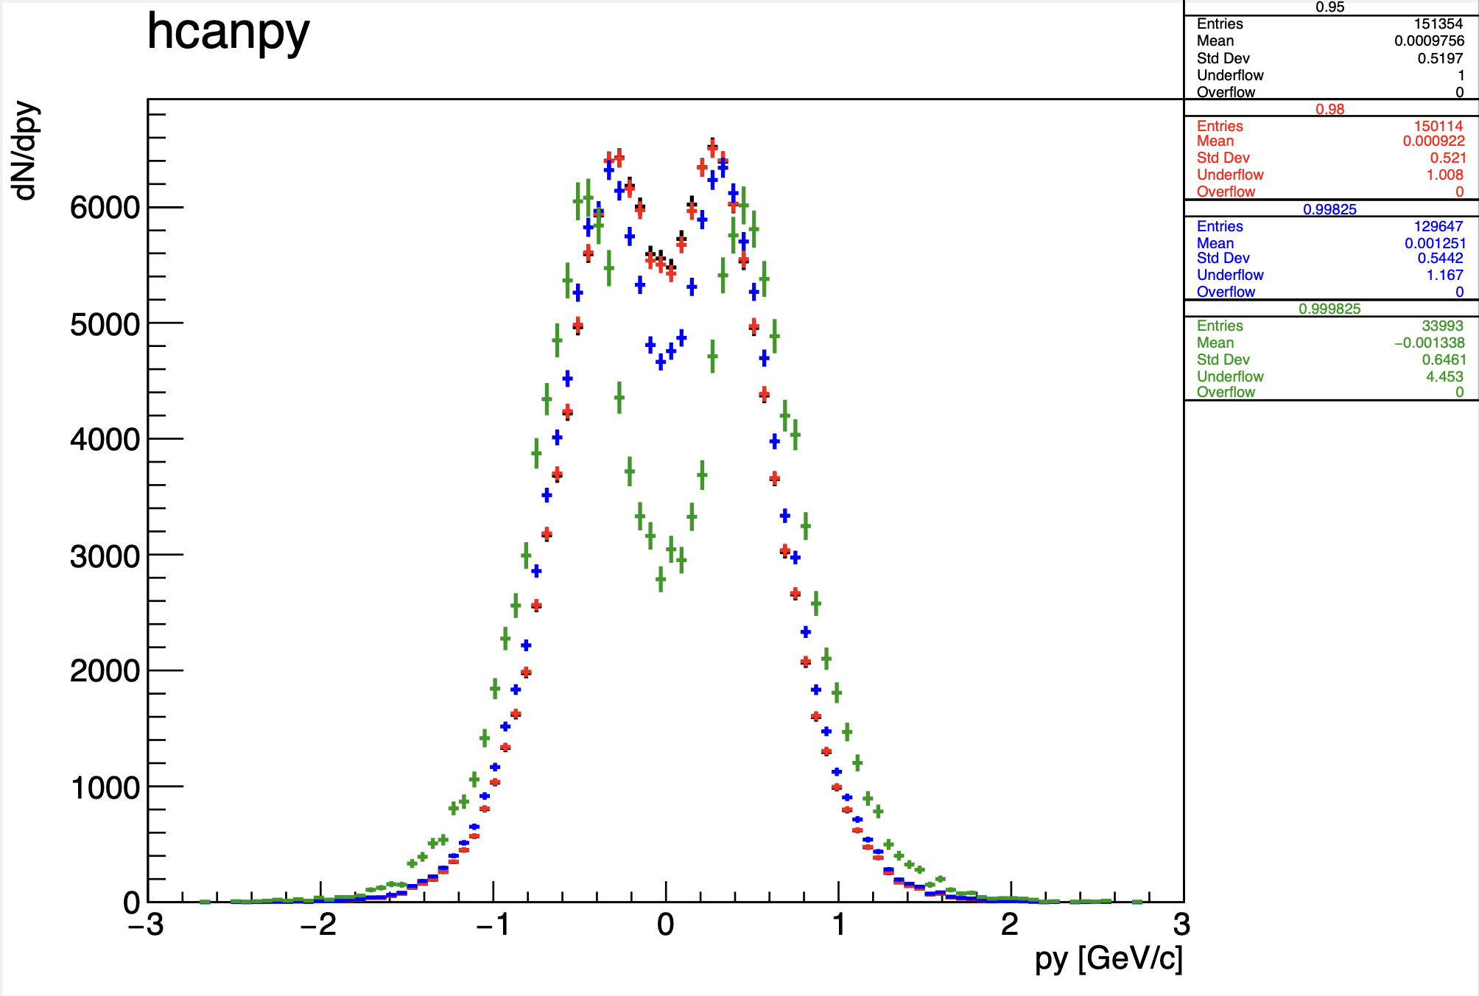
Momentums – e.g., p_{y}

Slide 23
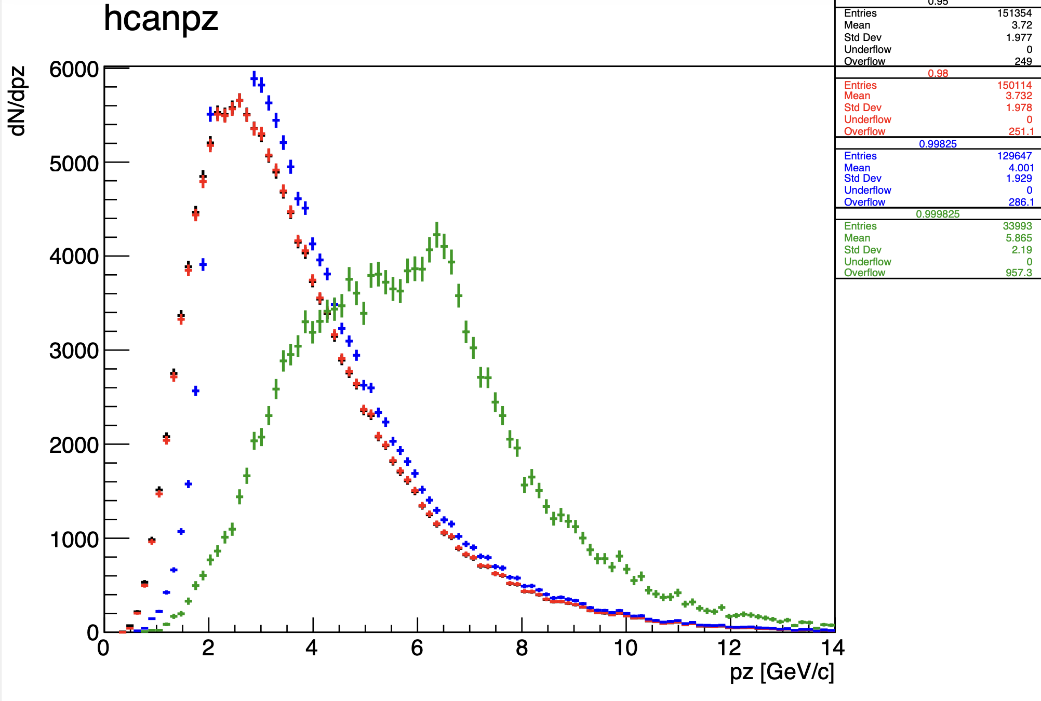
Momentums – e.g., p_{z}

Slide 24
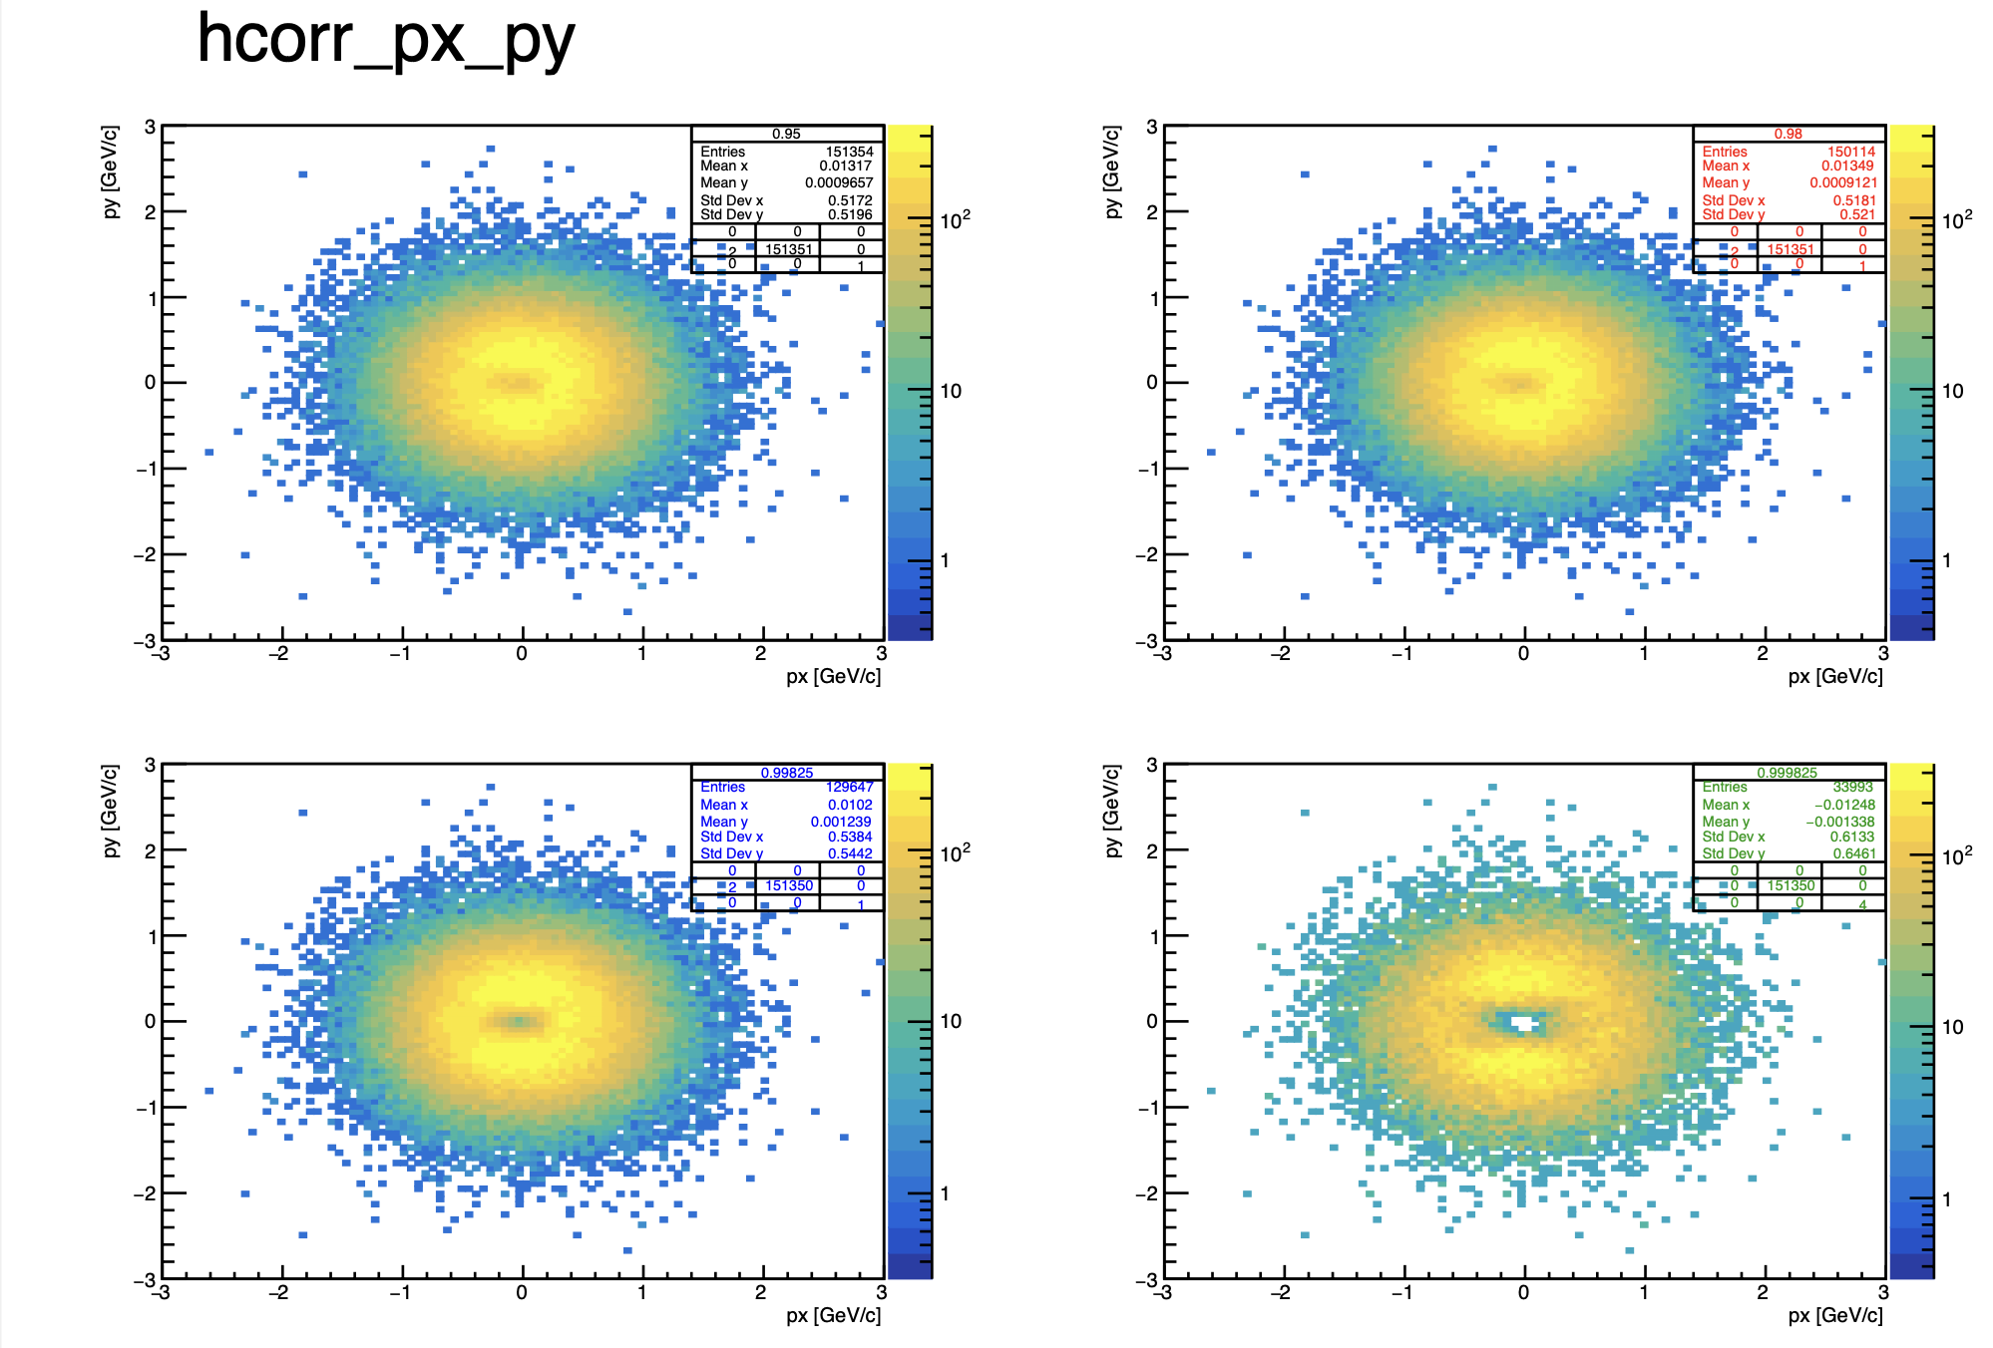
Correlations: reconstructed p_{x}- p_{y}

Slide 25
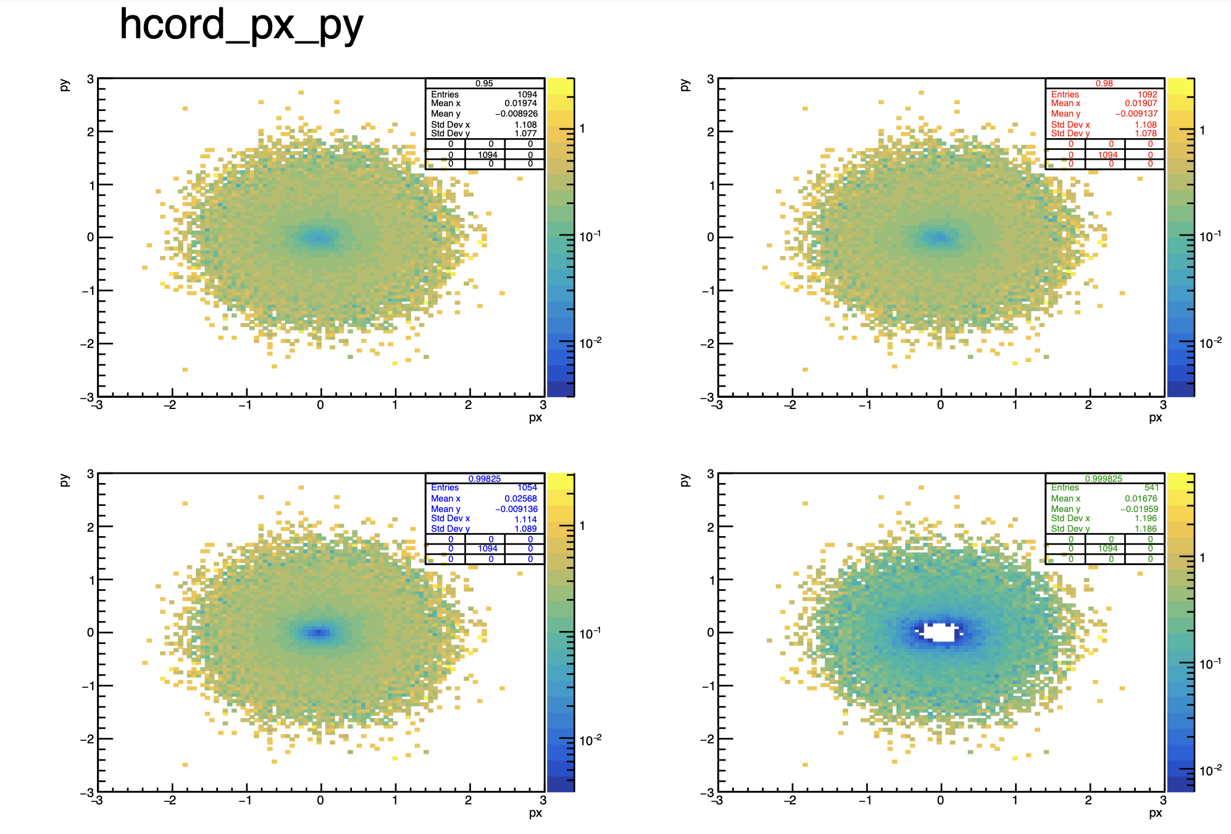
Correlations: rec-sim p_{x}- p_{y} (division)

Slide 26
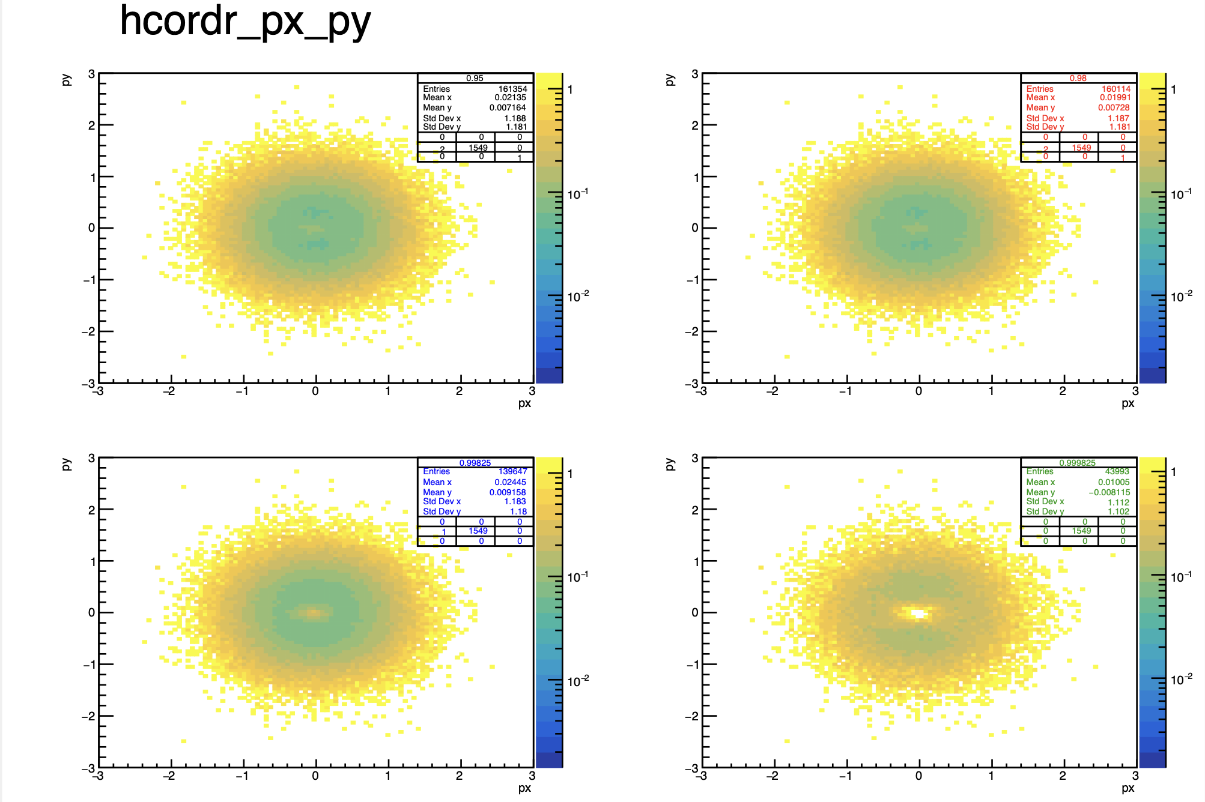
Correlations: rec-sim p_{x}- p_{y} (relative error)

Slide 27
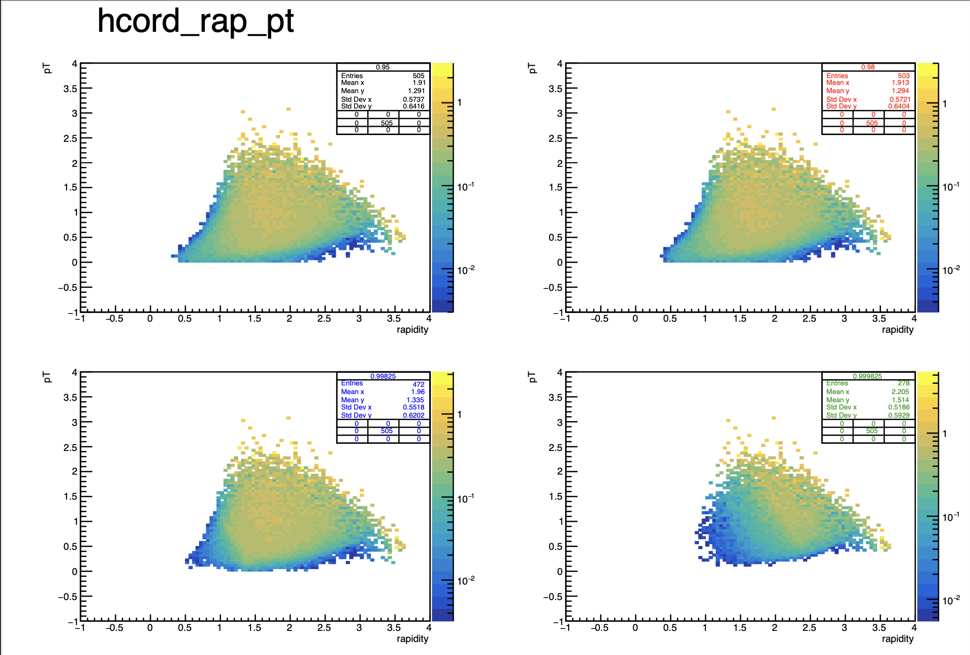
And for more correlations… e.g., rapidity-p_{T}

Slide 28
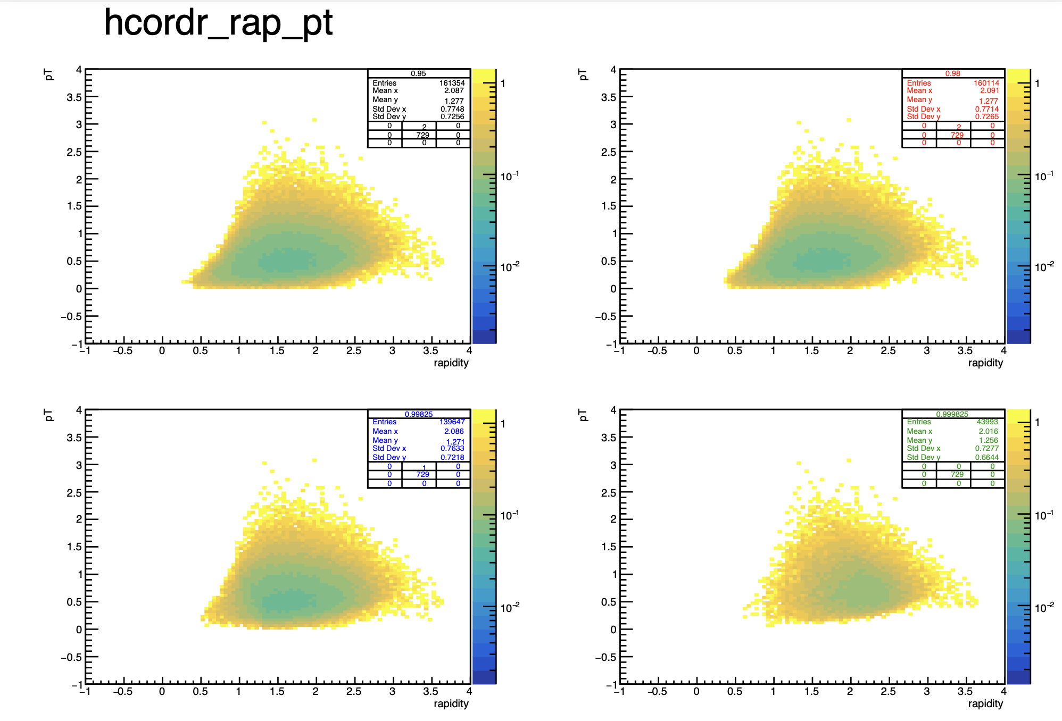
Correlation rapidity-p_{T}

